Slide 1

  ПЕТС Дистрикт 2482
  Пловдив - 22 Mарт 2014
Ариане Хангартнер
Офис на РИ Европа/Африка
Подпомагане на клубове и дистрикти
Notes:
(Introduction: presenter welcomes everyone, introduces him/herself, etc…)
[click]

Slide 2
СЕМИНАР ЗА ОБУЧЕНИЕ НА ЕЛЕКТ ПРЕЗИДЕНТИ 2014
Цели на обучението
Ръководство,секретариат и персонал на РИ
Нашият нов уебсайт www.rotary.org
  Моят Ротари
    Предприемане на действия
    Обучение и референции
    Управление
  Ротари клуб централ
Полугодишен отчет ( SAR )
  Нашата нова визуална индентичност
Notes:
Our learning objectives for this session are:
(Presenter clicks through and verbalizes the learning objectives)
(CLICK) Getting to know Rotary’s Leadership, the staff and the way we can support you in achieving our overall objectives
Exploring the new website and the main online (CLICK) resources and tools for Club Officers
(CLICK )The Semi-annual report and the recent changes approved by the Board at its January 2014 meeting.
(CLICK) Understand the importance of Rotary’s New Visual Identity

Slide 3
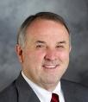
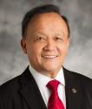


РЪКОВОДНА СТРУКТУРА НА РОТАРИ
2013-14 Борд на Директорите
РИ Президент
Рон Д.Бъртън
Елект Президент
Гари С.К. Хуанг
Тръст комитет на ФР
Председател Д.К.Лии
РИ Секретариат
Генерален секретар
Джон Хюко
Информацион-
нен отдел
Финансов
отдел
Отдел
Комуникации
Отдел
членство
Стратегия
и управление
на проекти
Фондация
Ротари
Notes:
Rotary’s leadership team reflects the diverse cultures and occupations of our more than 1.2 million members around the world. Whether helping to develop Rotary policy, providing financial support, managing a global staff, or advancing Rotary’s strategic plan, each member of the team is dedicated to helping our volunteers connect, communicate, and take action to create positive change. [click]
Rotary’s president presides over the Board of Directors and is elected to a one-year term. [click]
The RI president-elect is a Board member while preparing for his year in office. [click]
The Trustees of The Rotary Foundation are in charge of all matters concerning the Foundation. The Trustee Chair is elected by the trustees and serves for one year. [click]
Our General Secretary is appointed by the RI Board and serves as the chief operating officer of RI and The Rotary Foundation. As such, he is a member of, and reports to, both the RI Board and the Trustees. [click]
At the same time, he is the head of the RI Secretariat, supervising all the operations of its various departments and sections. This includes the operations of the various Secretariat offices on different continents. [click]

Slide 4

ПЕРСОНАЛ НА РОТАРИ,КОЙТО ВИ ОБСЛУЖВА
  ГЛОБАЛНА МРЕЖА
Световна
централа
Офис Европа/Африка
Notes:
Rotary International offices form a global network of support for Rotarians worldwide. [click]
The World Headquarters of the RI Secretariat is located in Evanston, Illinois, USA; near the city of Chicago. [click]
In addition, there are several regional offices situated in various countries throughout the world. [click]
The Europe/Africa Office, in Zurich, Switzerland (also known by its abbreviation EAO) is the second-oldest RI Secretariat Office, established in 1925. It is the largest of the International Offices. As its name indicates, it serves the clubs and districts in Europe and Africa.
The other RI regional offices are located in Brazil , Argentina , India , Korea , Japan, and Australia.
Besides them, there is another Rotary office in England, which serves the clubs and districts of Rotary in Great Britain & Ireland. They have their own semi-autonomous structure within RI. [click]

Slide 5
ПЕРСОНАЛ НА РОТАРИ,КОЙТО ВИ ОБСЛУЖВА
Регион Европа/Африка в цифри
9 Зони
114 Държави
126 Дистрикта
8’288 Клуба
301’043
Ротарианци
Към 1 юли 2013
Notes:
In the Europe/Africa region there are currently about 300,000 Rotarians distributed throughout 114 countries. This means about 25 percent of all Rotarians worldwide.
[click]

Slide 6
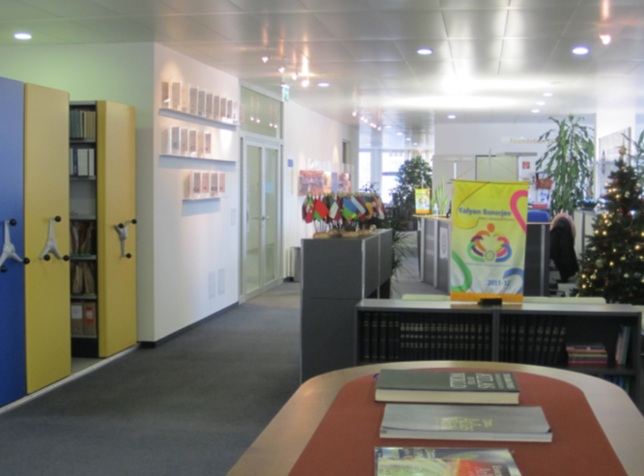
ПЕРСОНАЛ НА РОТАРИ,КОЙТО ВИ ОБСЛУЖВА
  Офис Европа/Африка (EAO)
  44 служители
  22 националности
  12 езика
Notes:
Considering the wide range of countries, cultures and languages of the districts served by the Europe/Africa Office, …
[click] … our staff comprises a well-balanced mix of people who reflect this variety. Between us, we represent numerous nationalities and cover several different languages.
[click]

Slide 7
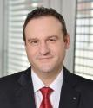

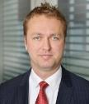
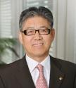
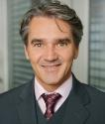
ПЕРСОНАЛ НА РОТАРИ,КОЙТО ВИ ОБСЛУЖВА
  Ръководство
Офис Европа/Африка
Марко Никозия
Офис Ръководител
Подпомагане
на клубове
и дисттрикти
Улпия Филипс
Ръководител
Фондация
Ротари
Еспин Малмберг
Ръководител
Финанси
Лосанг Риби
Ръководител
Бюро поръчки/
Публикации
Марчело Ботини
Надзорник
Notes:
Now looking at the organizational structure, our office has four main departments:
Club and District Support
The Rotary Foundation
Finance
Order Desk /Publications.
Let’s focus on each of them in turn.
[click]

Slide 8















ПЕРСОНАЛ НА РОТАРИ,КОЙТО ВИ ОБСЛУЖВА
  Подпомагане на клубове и дистрикти (CDS)
Улпия Филипс
CDS Manager
Координатор на
Административната група
IT-EN Team
FR-EN Team
EN Team
SW-EN Team
EN-FR Team
GE-EN Team
Reto Pantellini
Mireille Mettan
Peter Schnell
Inger Jaray
Graham Reoch
Stephanie
Theobald
Natalia
Anisimova-
Krucker
Kathrin Persiano
Catherine Nyfenegger
Ariane Hangartner
Gabriela Gustafsson
Tonja Cruse
Alexandra Bakanova
Notes:
Club and District Support (also known by its abbreviation CDS) consists of six small (mostly 2-person) teams. Each team is assigned to certain districts, so that the designated staff representatives specialize on, and are familiar with, your region.
Your CDS Team serves as your primary RI contact for all subjects other than those concerning Finance and The Rotary Foundation.
[click]

Slide 9
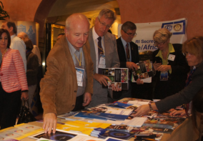

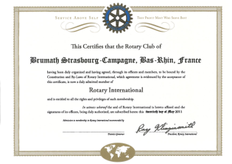
ПЕРСОНАЛ НА РОТАРИ,КОЙТО ВИ ОБСЛУЖВА
  Подпомагане на клубове и дистрикти
  Обучение
  Административни процедури
  Политика на Борда и учередителни документи
Notes:
In our role as your information resource we can support you by providing:
[click] … Training, such as at GETS, at the International Assembly, and for your PETS …
[click] … Assistance with administrative procedures such as admitting new clubs, and …
[click] … Guidance on RI Board policies and all of Rotary’s constitutional documents.
[click]

Slide 10
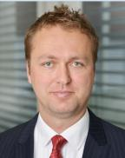
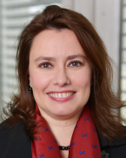
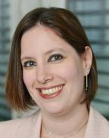
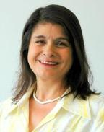
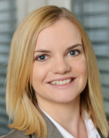
ПЕРСОНАЛ НА РОТАРИ,КОЙТО ВИ ОБСЛУЖВА
  Фондация Ротари
  Консултации по програми на ФР (TRF)
  Процедура за Paul Harris Fellows (PHFs)
Espen Malmberg
Manager
Lydia Alocen
Vanessa Court-Payen
Marta Wild
Clare Griffiths
Notes:
The staff members of our Foundation Department are also assigned to specific districts. They offer advice on …
[click] … The Rotary Foundation programs, and
[click] … process applications for Paul Harris Fellowships.
[click]

Slide 11
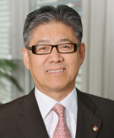
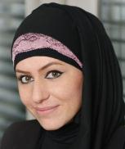
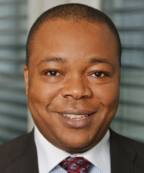
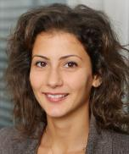
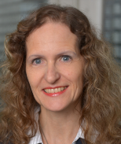
ПЕРСОНАЛ НА РОТАРИ,КОЙТО ВИ ОБСЛУЖВА
  Финансов отдел
  Консултации за Semi Annual Reports (SAR)
  E-SAR
  Директни плащания за Euro-zone (SEPA)
  Осчетоводяване на SAR плащания/
  и TRF дарения
Losang Ribi
Manager
Rima Gerber
Emmanuel Idehen
Serena Carandente
Charlotte Abächerli
Notes:
Similarly, the staff in our Finance Department can advise clubs on: …
[click] … The Semi-Annual Report (SAR) and payment of dues
[click] … How to go paperless with the SAR
[click] … The new direct debit system (for clubs in the Euro-zone countries).
[click] … They are also responsible for booking dues payments to RI, and donations to the Foundation.
[click]

Slide 12
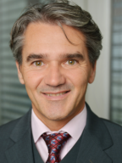
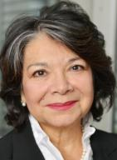
ПЕРСОНАЛ НА РОТАРИ,КОЙТО ВИ ОБСЛУЖВА
  Бюро да поръчки
  Информира относно публикации на РИ
  Обработва поръчки
  eao.order@rotary.org
Marcelo Bottini
Supervisor
Rhina Boehringer
Office Support Services
Notes:
The Order Desk …
[click] … gives information on RI publications and …
[click] … processes orders for these. RI publications – which are available in in seven languages – are sent to customers by mail, sometimes in bulk mailings when necessary. Rotarians can order publications via the general e-mail address:
[click] … eao.order@rotary.org OR via the RI web site by following the path: MY ROTARY > MANAGE > PRODUCTS & LITERATURE > SHOP .
[click]

Slide 13
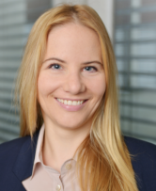
ПЕРСОНАЛ НА РОТАРИ,КОЙТО ВИ ОБСЛУЖВА
  Връзки с обществеността
  Подпомага ръководителите на Ротари в техните усилия да популяризират Ротари
  Контакти с медии в региона Европа/Африка
  Популяризира Ротари в медиите в Европа/Африка
Stéphanie Tobler Mucznik
Senior Media
Relations Specialist
Notes:
Further support is available from other specialist staff who cover the region as a whole.
Our Media Relations Specialist can offer advice on the subject of Public Relations. Her specific functions are to:
[click] … Support efforts to promote Rotary
[click] … Serve as the media contact for the region, and
[click] … Promote Rotary in the media.
[click]

Slide 14
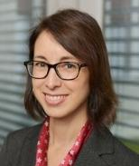
ПЕРСОНАЛ НА РОТАРИ,КОЙТО ВИ ОБСЛУЖВА
  Развитие на Фонда
  Подпомага ръководителите на ФР в техните усилия да популяризират Фондация Ротари
  Функционира като звено за контакт за основните донори в региона Европа/Африка
  Популяризира Фондация Ротари
Elizabeth Lamberti
Fund Development Advisor
Notes:
As regards The Rotary Foundation, we have a Fund Development Advisor who is here to:
[click] … Support efforts to promote The Rotary Foundation
[click] … Serve as the point of contact for major donors in the region, and
[click] … Promote The Rotary Foundation.
[click]

Slide 15

ПЕРСОНАЛ НА РОТАРИ,КОЙТО ВИ ОБСЛУЖВА
  Полио плюс
  Подпомага програмата ПолиоПлюс
  Подпомага да се координират усилията за насърчаване на ПолиоПлюс
Anna Rieder
Polio Advocacy Specialist
Notes:
In addition we have a Polio Advocacy Specialist, whose functions are to:
[click] … Support the PolioPlus Program, and
[click] … Help to coordinate PolioPlus advocacy efforts.
[click]

Slide 16
СЕМИНАР ЗА ОБУЧЕНИЕ НА ЕЛЕКТ ПРЕЗИДЕНТИ 2014
Цели на обучението
Ръководство,секретариат и персонал на Ротари
Нашият нов уебсайт www.rotary.org
  Моят Ротари
    Предприемане на действия
    Обучение и референции
    Управление
  Ротари клуб централ
  Полугодишен отчет (SAR)
  Нашата нова визуална индентичност
Notes:
Now that you are familiar with the services we can offer you, [click]
let’s have a a look at our Website www.rotary.org. [click]

Slide 17
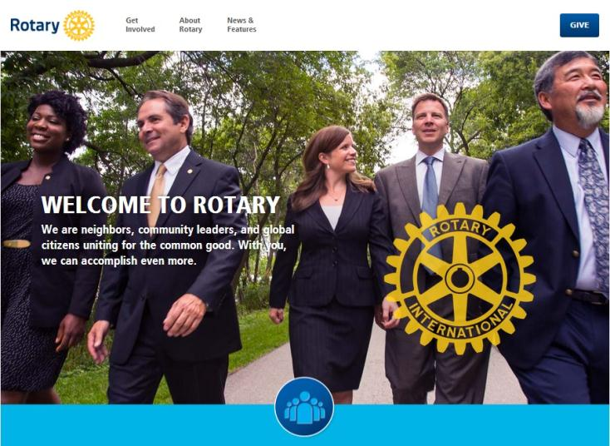

НАШИЯТ НОВ УЕБСАЙТ www.rotary.org
Notes:
I’m sure most of you have had a chance to explore our new website, launched in August 2013. Although our new website is still www.rotary.org, it now has a new look and is split into two sites: one for the general public and one for members.
This is a great tool you can use for attracting members and getting the community involved in your projects.
The public site gives general public information about our organization: it explains who Rotary is and what we do.
In the public site, you will find information on why to engage and [click] get involved with Rotary, that means [click]:

Slide 18
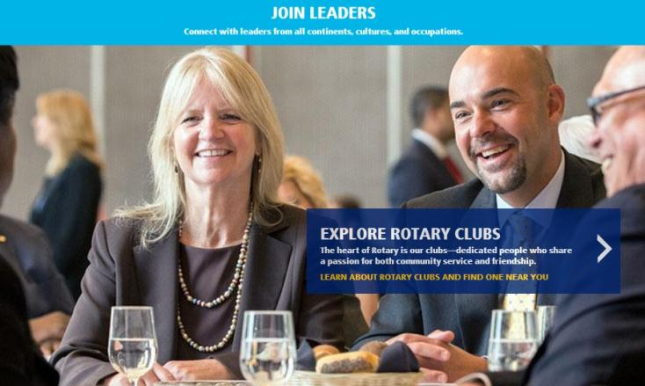
НАШИЯТ НОВ УЕБСАЙТ www.rotary.org
Notes:
how you can connect with leaders from all continents, cultures and occupations [click]

Slide 19
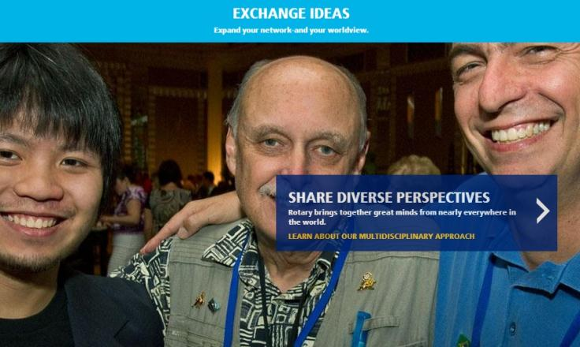
НАШИЯТ НОВ УЕБСАЙТ www.rotary.org
Notes:
How you can discover and celebrate diverse perspectives [click]

Slide 20

НАШИЯТ НОВ УЕБСАЙТ www.rotary.org
Notes:
and how you can create positive change in our communities. [click]

Slide 21
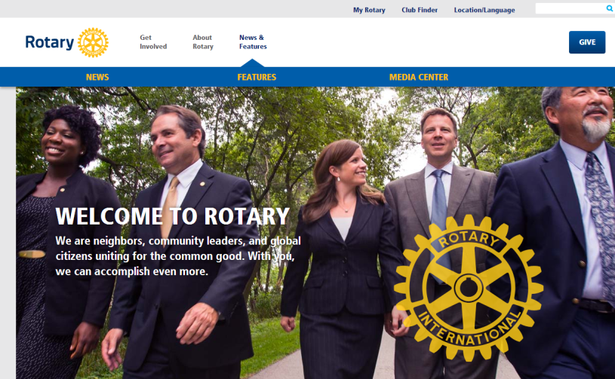
НАШИЯТ НОВ УЕБСАЙТ www.rotary.org
Notes:
On the public part of the website, you will also be able to access pages with Rotary news and a media center.
Let’s now talk about MyRotary, [click] the member site, optimized for members of the Rotary family. [click]

Slide 22

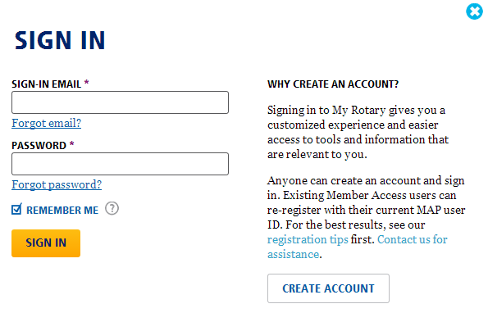
МОЯТ РОТАРИ – КАК ДА СЕ РЕГИСТРИРАМ ?
Notes:
To create your personal My Rotary account, click on [click] SIGN IN/REGISTER and then on CREATE ACCOUNT. [click]

Slide 23
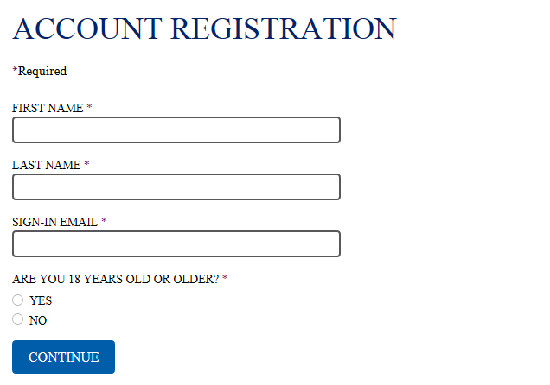
МОЯТ РОТАРИ – КАК ДА СЕ РЕГИСТРИРАМ ?
Notes:
Enter your first and last name, email address and provide an answer to the age-security question. You will receive an automatic activation email, allowing you to finalize the registration process. [click]

Slide 24
СЕМИНАР ЗА ОБУЧЕНИЕ НА ЕЛЕКТ ПРЕЗИДЕНТИ 2014
Цели на обучението :
Ръководство,секретариат и персонал на Ротари
Нашият нов уебсайт www.rotary.org
  Моят Ротати
    Предприемане на действие
    Обучение и референции
    Управление
  Ротари клуб централ
  Полугодишен отчет (SAR)
  Нашата нова визуална индентичност
Notes:
This brings us to the next item on our agenda, which is My Rotary. [click]

Slide 25
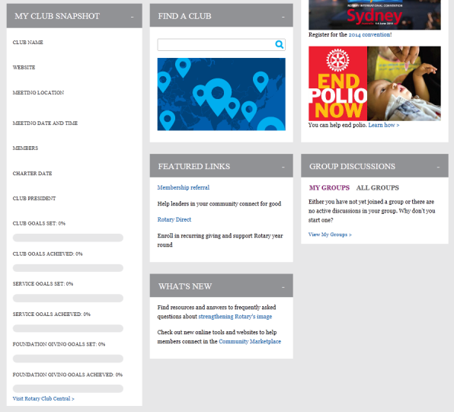
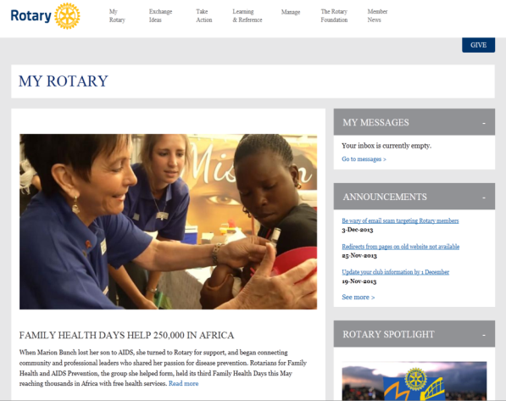
МОЯТ РОТАРИ – НАЧАЛНА СТРАНИЦА
Notes:
Once registered, you will land on the homepage of My Rotary, which contains a personal dashboard. It helps you find the information which is more relevant to you: you will find a highlighted story, your messages, important announcements, [click] your Rotary club snapshot, which will give you an instant view of your club’s goals and progress, the club finder and a link for participating in discussion groups. You can also access Rotary Club Central [click], the tool allowing you to monitor your club’s goals and activities. We will take a closer look at Rotary Club Central a bit later. [click]

Slide 26
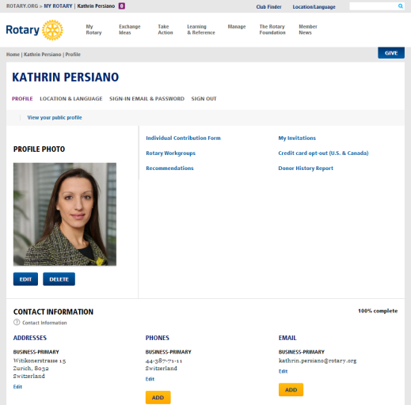
МОЯТ РОТАРИ - ПРОФИЛ
Notes:
By clicking on your name on the top left-hand corner of the homepage, you will have the option to create your profile. Here you can add some additional information about yourself. [click]

Slide 27
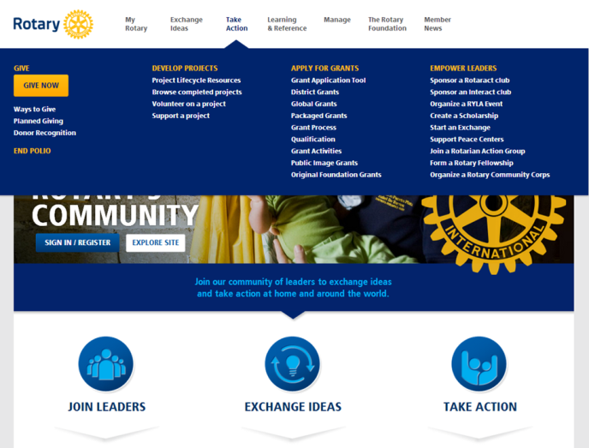
МОЯТ РОТАРИ – ПРЕДПРИЕМАНЕ НА ДЕЙСТВИЯ
Notes:
In the Take Action section of My Rotary, you will get everything you need to take your project from idea to completion. Whether you’re an experienced project leader or you're creating your first project, our project lifecycle resources can help bring your project to life. You may also explore the grant types and find one that’s right for your project. [click]
Click on BROWSE COMPLETED PROJECTS and you will be taken to Rotary Showcase. [click]

Slide 28
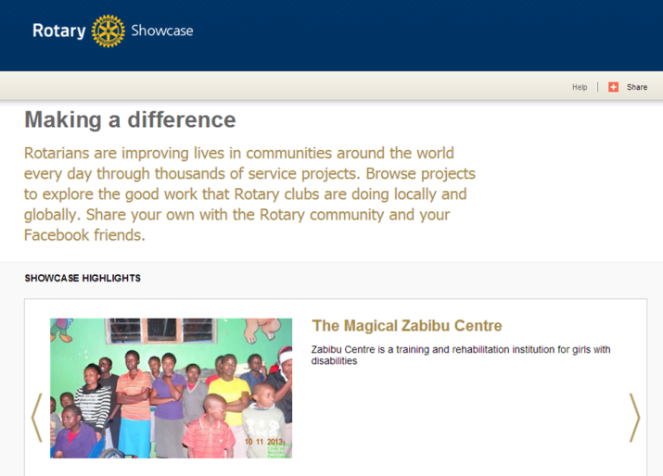
МОЯТ РОТАРИ – ПРЕДПРИЕМАНЕ НА ДЕЙСТВИЯ – ROTARY SHOWCASE
Notes:
Rotary Showcase allows you to see what Rotarians around the world are accomplishing. Read about projects in your own community and across the globe, and be inspired by the positive change we’re creating. Of course, we encourage you to promote your own projects in Showcase - it's the easiest way to share your project with the Rotary world and the public. [click]

Slide 29
МОЯТ РОТАРИ – ПРЕДПРИЕМАНЕ НА ДЕЙСТВИЯ
Notes:
[click] The SUPPORT A PROJECT link will take you to another of our great online tools – Ideas [click]

Slide 30
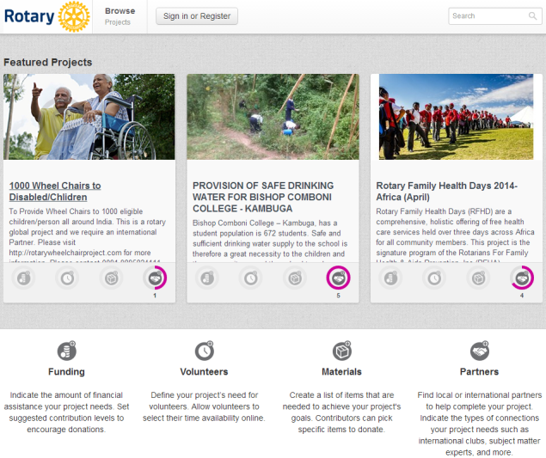
МОЯТ РОТАРИ – ПРЕДПРИЕМАНЕ НА ДЕЙСТВИЯ – ИДЕИ
Notes:
Ideas helps your clubs connect with project partners and find support for your service project. You can post service projects to help raise awareness and find project contributors by soliciting for funds, volunteers, resources and partnerships from Rotarians and non-Rotarians alike. Other site visitors can browse projects in need of assistance; contribute time, money or resources or partner through the tool. [click]

Slide 31
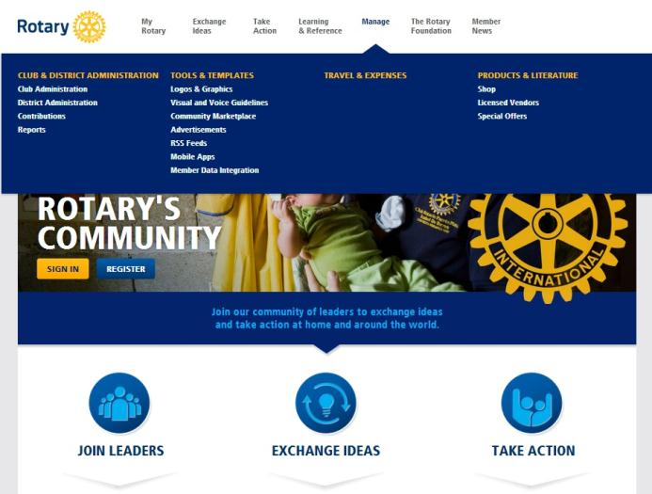
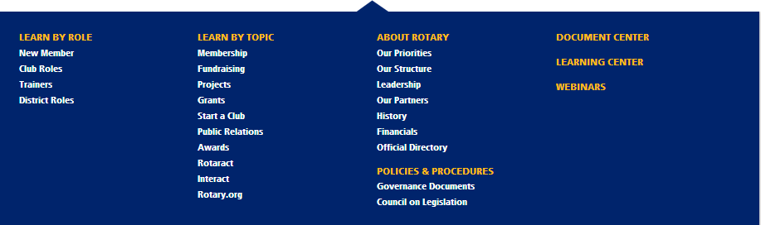
МОЯТ РОТАРИ – ОБУЧЕНИЕ И РЕФЕРЕНЦИИ
Notes:
Another important section of My Rotary is Learning and Reference, which is where you can access all of the training information by role or by topic and other materials for reference such as the Official Directory [click] and the Manual of Procedure [click]. In the same section, you will useful courses in the Learning Center [click], and webinars [click] you can register or listen to. [click]
Go to the Document Center …[click]

Slide 32
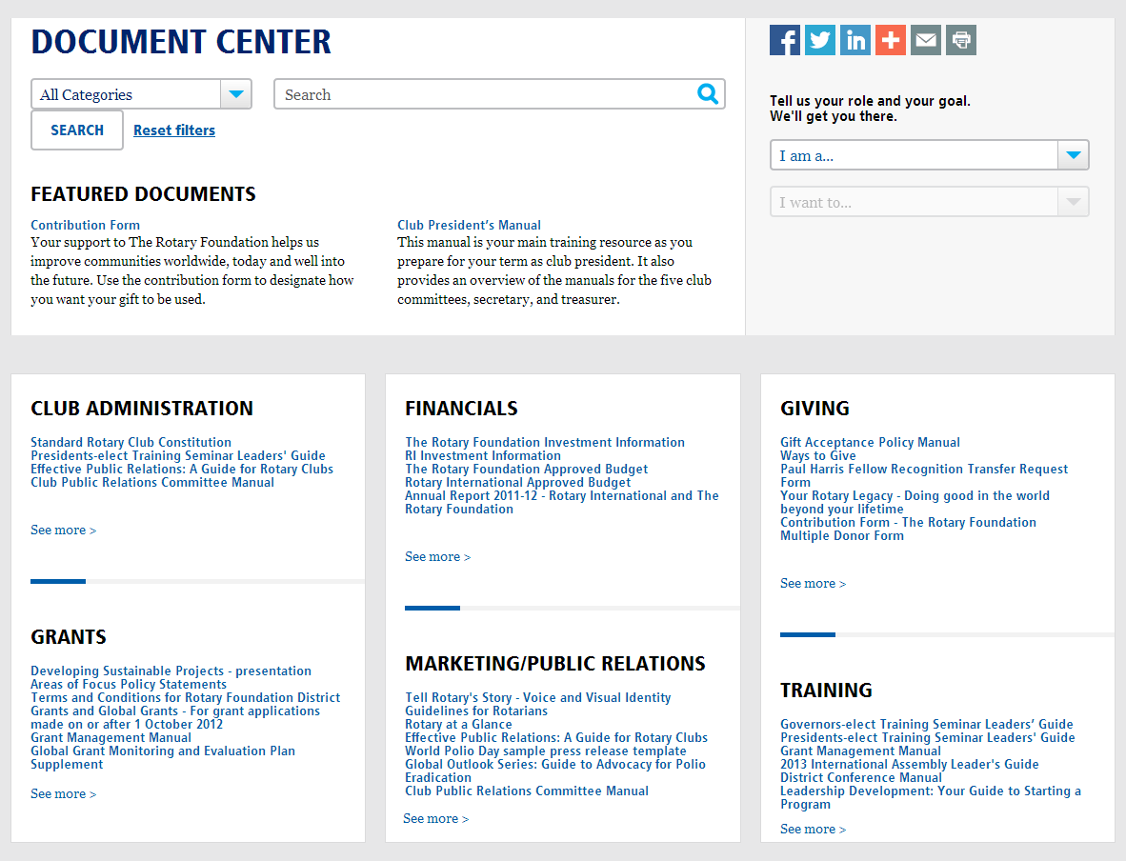
МОЯТ РОТАРИ – ОБУЧЕНИЕ И РЕФЕРЕНЦИИ – ДОКУМЕНТЕН ЦЕНТЪР
Notes:
…to browse and download for free many of the forms, training manuals and information sheets that are produced by Rotary.
You can search by topic, simply by clicking on the section you are interested in, such as:
Club Administration
Financials
Giving
Grants
Marketing/Public Relations
Training
[click]
You can also search by category, just by selecting one of the 33 categories from the drop-down search menu under the arrow.
Categories such as: Areas of focus, Awards, Club Administration, Grants, History, Social Media, Training and Travel Services.
Of course you can also just use the search box to find documents by keyword or by publication name. [click]

Slide 33
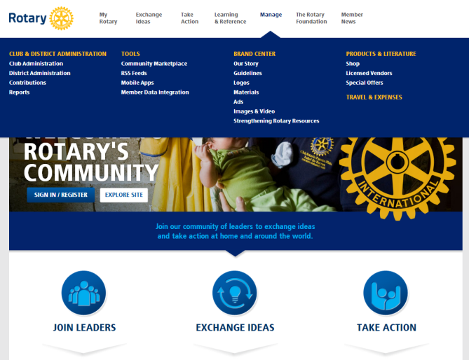
МОЯТ РОТАРИ – УПРАВЛЕНИЕ – КЛУБНА АДМИНИСТРАЦИЯ
Notes:
The third and most important section of My Rotary for you as a club officer is Manage [click].
WHY IS THIS SO IMPORTANT FOR YOU?
It is where you will find all the tools to administer your club! (in the section Club Administration.) [click]

Slide 34


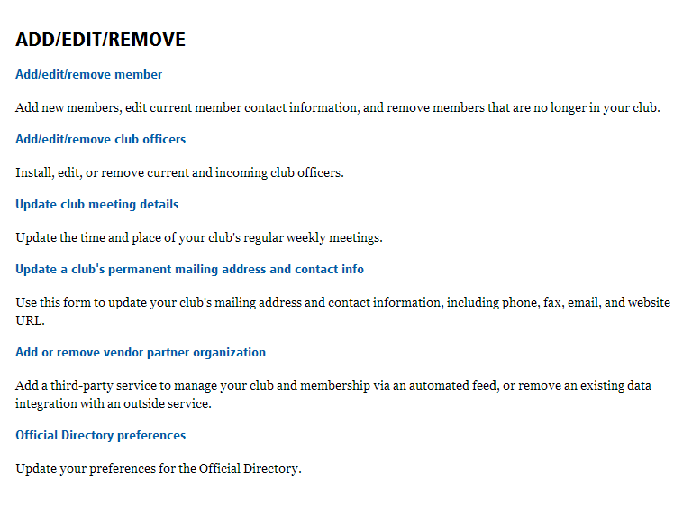
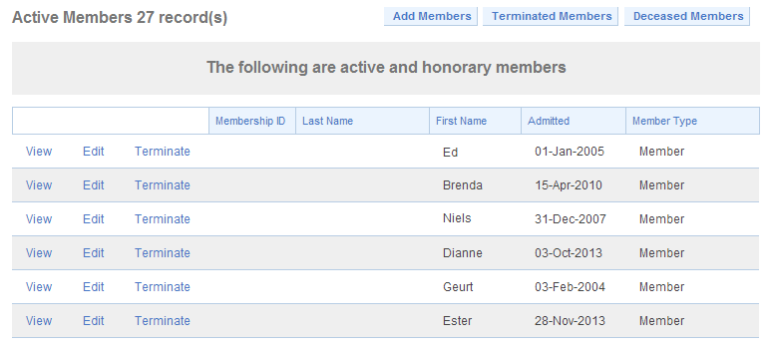
МОЯТ РОТАРИ – УПРАВЛЕНИЕ – КЛУБНА АДМИНИСТРАЦИЯ
Notes:
In Club Administration, you will see a list of links to tools, information and reports.
Let’s go over the most important items and explain what you can do with them.
Under ADD/EDIT/REMOVE, where you will find the [click] Add/edit/remove member button, which will take you the official club membership list.
Next to the name of every member, you will see three buttons: [click] View, Edit, and Terminate. Click on these buttons to view a member’s record, edit it, or terminate the person’s membership in your club respectively.
[click] The Add Members button at the top enables you to create new membership records for first-time Rotarians as well as transfer former members of another Rotary club to your club. If you know that a new member has been a Rotarian before, please always find his old record and add him to your club. This avoids duplicate records and ensures that the donation recognition and membership history stays with the Rotarian.
[click]

Slide 35
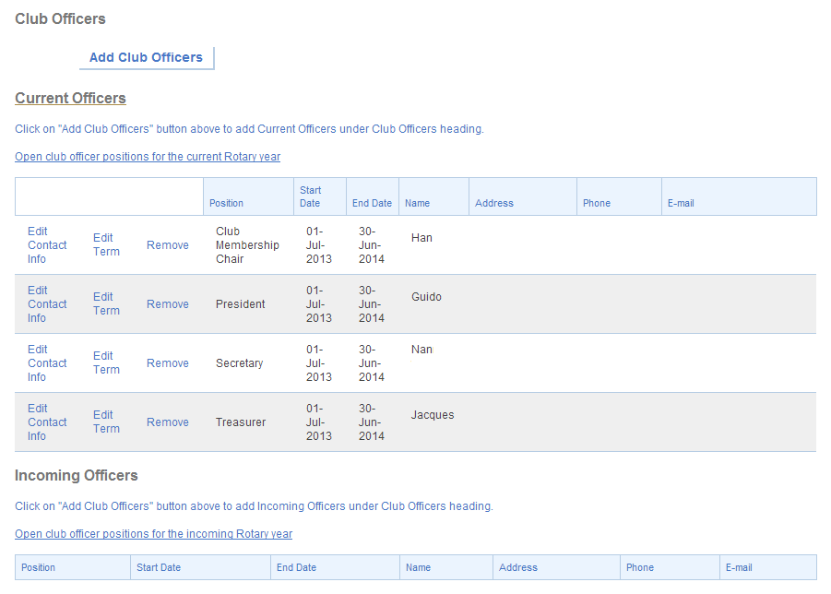
МОЯТ РОТАРИ – УПРАВЛЕНИЕ – КЛУБНА АДМИНИСТРАЦИЯ
Notes:
Clicking on Add/edit/remove club officers [click] shows us a list of current and incoming officers currently reported in the Rotary database.
By clicking on the Add Club Officers button at the top of the screen, you can assign club officer positions to members in your club.
Always ensure that both the current and incoming officers are updated in RI’s database and check that we have their correct contact details. Only club officers who are reported to RI will receive the correct access rights in My Rotary and receive important mailings from RI.
In the example on screen, the club has reported [click] four of its current officers, but still needs to report all its incoming officers [click] for the next Rotary year. Please report your incoming officers as soon as they are known. [click]

Slide 36
МОЯТ РОТАРИ – УПРАВЛЕНИЕ – КЛУБНА АДМИНИСТРАЦИЯ
Notes:
Still under the heading on the Club Administration page, you will also find the links to update your club’s meeting details, and change your club’s permanent mailing address and contact info.
Please note that club contact information will be published in Rotary media, including the Club Locator on the Rotary website. Club officer information, on the other hand, will be published in the Official Directory, which is only accessible to Rotarians.
[click]

Slide 37
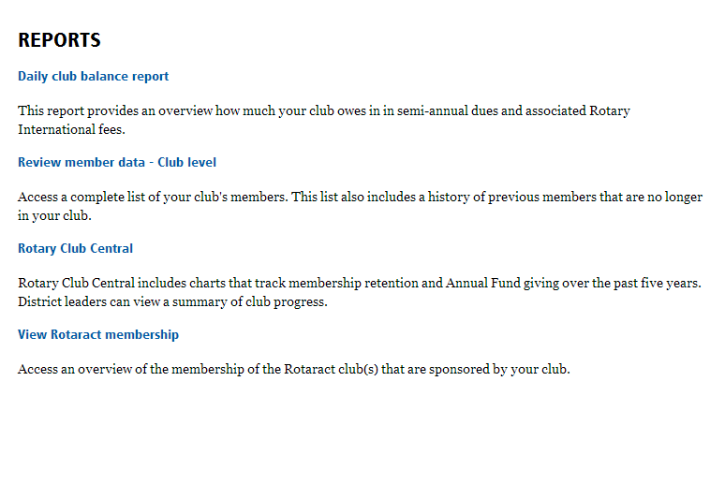
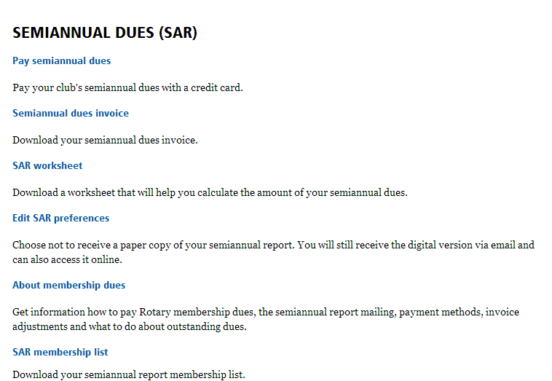
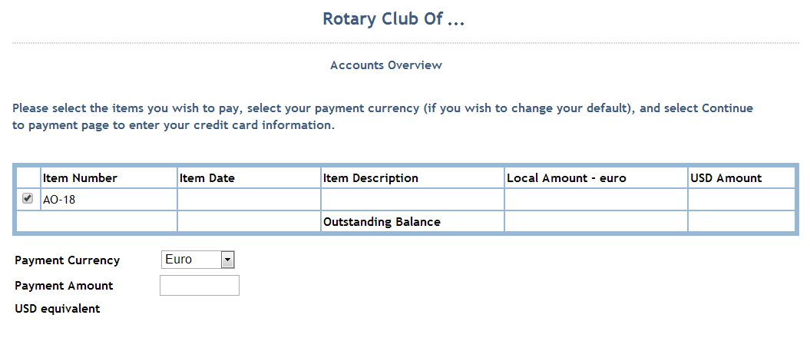
МОЯТ РОТАРИ – УПРАВЛЕНИЕ – КЛУБНА АДМИНИСТРАЦИЯ
Notes:
Another section under Club Administration is the Semiannual Dues or SAR section. SAR stands for Semi-Annual report, which is used for calculating and paying membership dues to Rotary.
Club officers receive an electronic copy of the semiannual report in early July and January, and some club secretaries may also still receive a paper copy if they have chosen this option on the Rotary website.
Click on the Pay semiannual dues [click] see the outstanding balance and pay the club's semiannual dues online with a credit card. [click]

Slide 38
МОЯТ РОТАРИ – УПРАВЛЕНИЕ – КЛУБНА АДМИНИСТРАЦИЯ
Notes:
Clicking on Semiannual dues invoice, enables you to download the actual semiannual dues invoice.
[click] Click on the SAR worksheet to make any corrections and calculate the amount payable for semiannual dues.
[click]

Slide 39
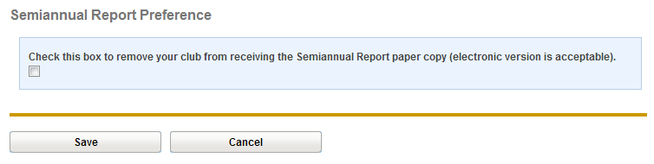
МОЯТ РОТАРИ – УПРАВЛЕНИЕ – КЛУБНА АДМИНИСТРАЦИЯ
Notes:
In Edit SAR preferences you can choose not to receive a paper copy of your semiannual report. You will always receive the digital version via email and will also be able to access it online.
We will look at the Semi Annual Report and change in the collection cycle in a few minutes. [click]

Slide 40
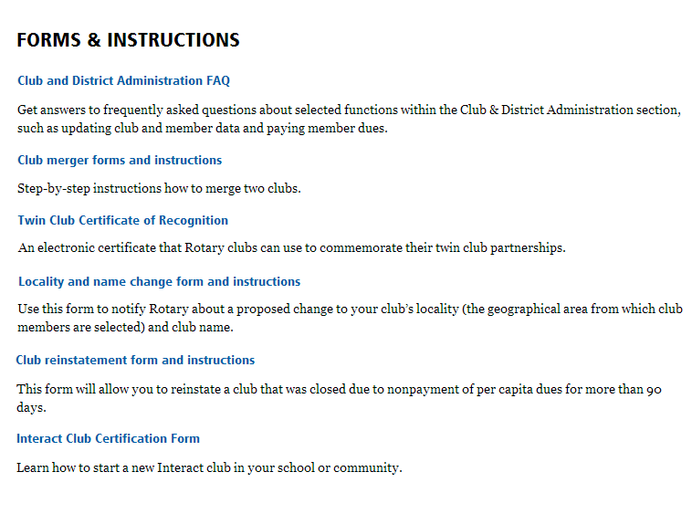
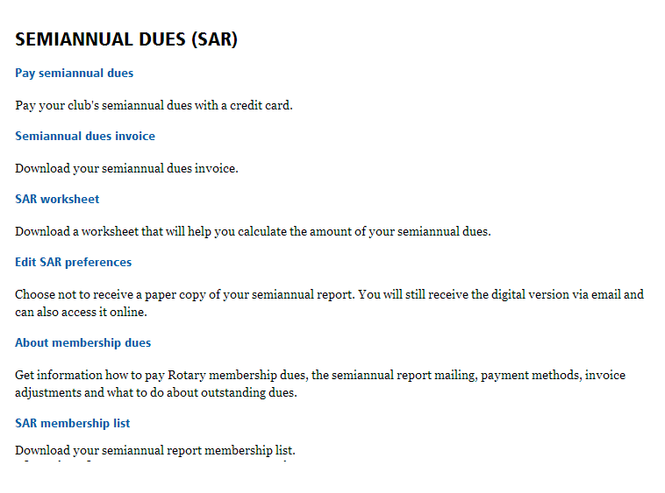
МОЯТ РОТАРИ – УПРАВЛЕНИЕ – КЛУБНА АДМИНИСТРАЦИЯ
Notes:
Moving further down our list of useful club administration tools, forms and links, we come to the FORMS & INSTRUCTIONS section.
Here you can find Frequently Asked Questions about Club & District Administration, and a number of official forms you may need as a club.
[click]

Slide 41
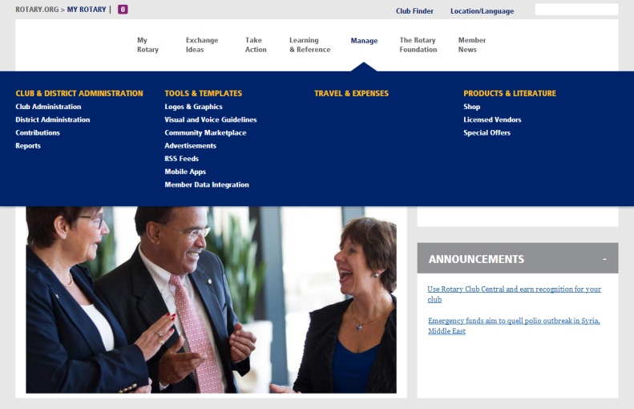
МОЯТ РОТАРИ – УПРАВЛЕНИЕ – ОТЧЕТИ
Notes:
In addition to club administration tools, you can also find useful REPORTS in the Manage section. Go back to [click] Manage to make the drop-down menu appear. Still under the heading «Club & District Administration» , click on REPORTS. [click]

Slide 42
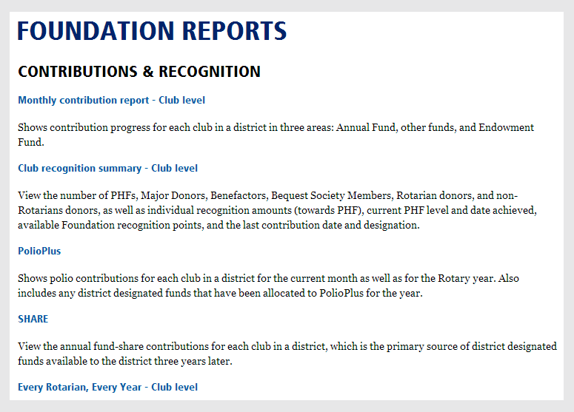
МОЯТ РОТАРИ – УПРАВЛЕНИЕ – ОТЧЕТИ
Notes:
Here you will find a useful list to various reports.
For example, under «Contribution and Recognition», a very commonly requested report is the [click] Club recognition summary – club level. This report will show you the current donor level status of all your club members, and it also gives the number of Foundation recognition points currently owned by your club. [click]

Slide 43
МОЯТ РОТАРИ – УПРАВЛЕНИЕ – МАГАЗИН
Notes:
Now we are coming to our online Shop which you can access through the Manage section [click]
WHY VISIT OUR ONLINE SHOP ?
To find a wide variety of Rotary publications to help you promote your projects, develop your membership, and/or your public relations, etc. [click]

Slide 44

МОЯТ РОТАРИ – УПРАВЛЕНИЕ – МАГАЗИН
Notes:
At Rotary’s online Shop you can search by category:
Avenues of service
History
Leadership Training
Membership Development
Public Relations
RI Theme Materials
The Rotary Foundation
Alternatively you can browse by media type:
Books
Brochures and Promotional Items
Certificates and Awards
Forms
Kits
Training Manuals
Videos and Multimedia
[click] You can also just use the search box to find documents by keyword or publication name. [click]

Slide 45
СЕМИНАР ЗА ОБУЧЕНИЕ НА ЕЛЕКТ ПРЕЗИДЕНТИ 2014
Цели на обучението:
Ръководство,секретариат и персонал на Ротари
Нашият нов уебсайт www.rotary.org
  Моят Ротари
    Предприемане на действие
    Обучение и референции
    Управление
  Ротари клуб централ
  Полугодицен отчет (SAR)
  Нашата нова визуална индентичност
Notes:
Now, let’s turn to Rotary Club Central
[click]

Slide 46






РОТАРИ КЛУБ ЦЕНТРАЛ
Централизира информцията
Елиминира формулярите на хартиен носител
Насърчава последователност в ръководството
Прозволява на клубовете да проследяват своя напредък
Създава прозрачност
Демонстрира важната работа, която Ротари клубовете изпълняват по цял свят
Notes:
FIRST OF ALL, WHY IS ROTARY CLUB CENTRAL SUCH AN ESSENTIAL RESOURCE FOR YOUR CLUB?
[click] It centralizes information. It provides access to all the data that was previously available from several reports.
[click] It eliminates some paper. It replaces paper forms for membership and Rotary Foundation goals as well as the Planning Guide for Effective Rotary Clubs.
[click] It fosters continuity in leadership. Club leaders change annually, so by offering them the ability to see a history of goals and achievements, it creates continuity among leaders.
[click] It enables clubs to track their progress. Club leaders can determine whether the goals they’ve set are realistic and make changes if needed.
[click] It creates transparency. All club members are able to see club goals.
[click] It showcases the important work that Rotary clubs do worldwide. Until now, Rotary has not had a vehicle for collecting information about the millions of service projects that Rotarians undertake. With Rotary Club Central, clubs can document the details of their projects, such as the number of volunteers and volunteer hours and a list of in-kind donations.
[click]

Slide 47


РОТАРИ КЛУБ ЦЕНТРАЛ
Notes:
There are a few ways to access Rotary Club Central from the new website. The most direct way is from the “My Rotary” page where you will see [click] “My Club Snapshot.”
From here, [click] you can see some of your club’s details (such as meeting location, website, charter date, members, etc.) You can also see a summary of how many goals your club has set and achieved in each section of Rotary Club Central. [click]

Slide 48
РОТАРИ КЛУБ ЦЕНТРАЛ
Notes:
At the bottom of the club snapshot, you can click “Visit Rotary Club Central” to start viewing and editing goals. [click]
It can also be accessed from “Club and District Administration” under Manage. [click]

Slide 49

РОТАРИ КЛУБ ЦЕНТРАЛ
Notes:
You will always begin at the Your Club tab [click].
You can see that in addition to Your Club, there are tabs for Service and Foundation Giving [click].
For Your Club, we start with the Trends section [click] which shows your club’s membership retention over the last five years.

Slide 50



РОТАРИ КЛУБ ЦЕНТРАЛ
Тенденции в членството
Начални и крайни дати (5 годишна тенденция)
Пол (3 годишна тенденция)
Възрастова тенденция (3 годишна тенденция)
Notes:
If you scroll further down the page, you will see more membership trends,
[click] starting with the membership start and end dates over the past 5 years
[click] as well as gender
[click] and age trends over the last 3 years.
While these aren’t goals, seeing the trends can help your club strive for a more balanced membership. [click]

Slide 51




РОТАРИ КЛУБ ЦЕНТРАЛ
Вашият клуб
Запазване на членството
Ангажиране с Ротари
Комуникации между клубовете
Връзки с обществеността
Notes:
Further down the page, in the section “Goal and Progress”, you can set your main goals in the four following categories:
[click] Membership Retention
[click] Rotarian Engagement
[click] Club Communication
[click] und Public Relations
[click]

Slide 52

РОТАРИ КЛУБ ЦЕНТРАЛ
Notes:
Moving on to the Service tab, you’re presented with a trend graph displaying a breakdown of the impact achieved from your club’s service projects and activities over the last three years. The four impact measures are number of volunteers, total volunteer hours, cash donations, and in-kind donations. [click]

Slide 53



РОТАРИ КЛУБ ЦЕНТРАЛ
Услуги
Проекти и дейности във връзка с услуги
Клубове от ново поколение
Участници от ново поколение
Notes:
Scrolling down, there are three main goals here, which are;
[click] Service Projects and Activities (which can be imported from or shared with Rotary Showcase)
[click] New Generations Clubs (which includes sponsoring Rotaract and Interact clubs),
[click] and New Generations Participants (which covers Youth Exchange and RYLA).
[click]

Slide 54

РОТАРИ КЛУБ ЦЕНТРАЛ
Notes:
And lastly, on the Foundation Giving tab, this trend graph shows your club’s Annual Fund goals and giving over the last 5 years.
[click]

Slide 55



РОТАРИ КЛУБ ЦЕНТРАЛ
|Фондация Ротари
Годишен фонд
Полио плюс
Основни дарения и Дарителски фонд
Notes:
Below the Annual Fund trends are the three main goals for Foundation giving:
[click] The Annual Fund is broken out by Paul Harris Society, Sustaining Members, EREY, and other contributions.
[click] Then we have PolioPlus.
[click] And last we have Major Gifts and Endowment Fund, which includes Major Gifts, Bequest Society, and Benefactors.
[click]

Slide 56

РОТАРИ КЛУБ ЦЕНТРАЛ
Notes:
Each tab [click] has a link to resources on the left hand navigation bar.
[click]
This will give you access to publications, web pages, and even videos that can assist you in setting goals for your club. [click]

Slide 57

РОТАРИ КЛУБ ЦЕНТРАЛ
Notes:
On the left side beneath Resources, we have Reports. [click]
From here, you can view and download reports that are related to each of the three tabs [click].

Slide 58

РОТАРИ КЛУБ ЦЕНТРАЛ
Notes:
As a club officer, most of your experience will be in the Club View, however, there are higher level views which can provide you with goal and progress summaries at the district and global level.
Seeing the global view can give you a broader perspective of things like the number of projects clubs are doing around the world, or the total number of Rotarians. [click]

Slide 59
РОТАРИ КЛУБ ЦЕНТРАЛ
Кой може да въвежда цели ?
Клубно ниво
Президент
Секретар
Касиер
преседател ФР
председател членство
изпълнителен секретар
Елект офицери
Дистриктно ниво
Дистрикт гуверньор
*АДГ
председатели на комитети
Изпълнителен секретар
Notes:
So, now that we’ve covered the basics, let’s talk about entering goals.
EVERYONE IN YOUR CLUB CAN VIEW GOALS, BUT WHO SPECIFICALLY CAN ENTER AND EDIT GOALS?
[click]
At the club level, your current president, secretary, treasurer, Foundation chair, membership chair, and executive secretary can all enter goals for the year they are in office, provided that they have been reported to Rotary International. You as an officer-elect can already record your goals for 2014-15. Ideally, club officers will enter their club’s goals during their elect year.
[click]
You might be interested to know that at the district level, your district governor, committee chairs, and district executive secretary can view and edit the goals for all clubs in the district for their year. Your assistant governor may view all goals but only edit the goals for the clubs he or she is responsible for. This is so that they can assist you with reporting your goals if needed. When goals are set on behalf of your club, an automated email is generated and sent to the current club president listing the goal change and who made the change.
[click]

Slide 60

РОТАРИ КЛУБ ЦЕНТРАЛ
Notes:
As already mentioned, the Rotary Club Central Club Reference Guide [click] outlines the steps for you to follow in order to set goals and report achievements.
Check it out and discover the benefits of Rotary Club Central today.

Slide 61
СЕМИНАР ЗА ОБУЧЕНИЕ НА ЕЛЕКТ ПРЕЗИДЕНТИ 2014
Цели на обучението :
Ръководство,секретариан и персонвал на Ротари
Нашият нов уебсайт www.rotary.org
  Моят Ротари
    Предприемане на действие
    Обучение и референции
    Управление
  Ротари клуб централ
  Полугодишен отчет ( SAR )
  Нашата нова визуална индентичност
Notes:
Let’s now turn to the Semi Annual Report [click]

Slide 62




ПОЛУГОДИШЕН ОТЧЕТ
Защо се плаща членски внос на Ротари ?
Notes:
As a member of Rotary International your club pays membership dues to the organization.
WHY IS IT IMPORTANT TO PAY DUES?
Well, your dues enable Rotary to:
[click] Provide high-quality information and support to Rotarians around the world
[click] Administer programs such as Rotaract, Interact and Youth exchange
[click] Support district governors financially during their year in service
[click] Provide publications and communications in several languages
[click]

Slide 63

ШЕСТМЕСЕЧЕН ОТЧЕТ ( SEMIANNUAL REPORT - SAR )
Какво е шестмесечен отчет (SAR )?
Шестмесечен отчет
  SAR фактура
  Инструкции за плащане
  Изчислителна таблица
Notes:
WHAT EXACTLY IS THE SAR?
SAR stands for [click] Semiannual Report’ and consists of [click] the SAR invoice, [click] payment instructions and [click] documents to calculate dues to RI. The SAR is sent to clubs twice a year at the end of June and the end December. It has both a financial function and a membership reporting function. (The SAR invoice consists of Per Capita membership dues, additional dues for the Council on Legislation and of subscription costs for The Rotarian magazine.)
[click]

Slide 64



ШЕСТМЕСЕЧЕН ОТЧЕТ
Как да подготвим шестмесечния отчет ?
Актуалициране на данните за членство до 1 юни и 1 декември.
Notes:
SO HOW DO YOU ENSURE THAT THE SAR IS CORRECT?
[click] First, you need to continuously update your clubs membership data to receive a correct SAR invoice. Do this at the latest by 1 June and 1 December. [click] You can do this online via Club administration in the Manage section of My Rotary.
[click] If your club is part of the OneRotary data integration initiative, you need to update your membership through your local database. Please check with your district for any further information. [click]

Slide 65


ШЕСТМЕСЕЧЕН ОТЧЕТ
Как се получава шестмесечния отчет ?
Изпраща ви се по email
Достъпен в Моят Ротари
Notes:
SAR is sent electronically to all club officers. [click] Please note that this requires your club officers to have their current email addresses in RI’s database. In addition, the SAR packet is sent by mail to those clubs that have not opted out of the paper version. Remember as mentioned before that that the latest version of your SAR packet is always available online [click] in My Rotary in the CLUB ADMINISTRATION under MANAGE. [click]

Slide 66


ШЕСТМЕСЕЧЕН ОТЧЕТ
Как се плаща шестмесечния отчет ?
Чрез кредитна карта
Чрез електронен трансфер на средства
  Чрез директен дебит
Notes:
You can pay the SAR online in My Rotary by [click] using a credit card. Please remember to note the transaction number of your payment for later reference.
[click] Alternatively, you can pay by bank transfer according to the details on the invoice, or via [click]
Direct Debit if your club has agreed to participate in this program offered to countries. SEPA stands for Single Euro Payments Area (SEPA). In this case, the dues will be automatically deducted by RI from your club’s bank account. (Note to presenter: to be mentioned only if applicable)
For further information please turn to the Finance representative assigned to your district, whose contact details you can find on the invoice. [click]

Slide 67

ШЕСТМЕСЕЧЕН ОТЧЕТ
Как да се потвърди членството за шестмесечния отчет?
Изпращане на email до data@rotary.org
  Клубен ID номер
  Брой членове
  Данни за абониране
  за списание
Notes:
In addition to paying the dues, your club needs to confirm the number of club members to RI (note for presenter: this will only be valid for SAR July 2014).
Please do this [click] by sending an e-mail to Data Services data@rotary.org with the following information: [click]
Club ID number and name
Active member count per 30 June or 31 December
Possible changes in subscriptions of “The Rotarian” magazine.
[click]

Slide 68
ПОЛУГОДИШЕН ОТЧЕТ
Кои дати трябва да се помнят ?
неплатено
неплатено
Актуализиране на членството 1 месец преди SAR
Чл.внос платим при получаване на SAR
Изпращане на напомняне до клуба
Закриване на клуба
May
Jun
Jul 2014
Aug
Sep
Oct
Nov
Dec
1Jan 2015
6 месеца
Notes:
Let’s have a look at the current timeline step by step:
Remember to update the membership figures of your club latest by 1 June.
[click] Your club then receives the SAR packet from RI with the due date of 1 July.
[click] In October, clubs with an open balance of 250 USD or more will receive a reminder.
[click] Clubs that have not paid by the end of December will be terminated in January.
IMPORTANT:
PLEASE NOTE THAT DURING THE ROTARY YEAR 2014-15 THERE WILL BE A CHANGE TO THIS PROCESS: [click]

Slide 69
ШЕСТМЕСЕЧНА ФАКТУРА И НОВ ЦИКЪЛ НА СЪБИРАНЕ
… към 1 януари 2015
непланено
неплатено
Редовна актуализация на данните за членството !!!
Чл.внос платим при получаване на SAR
Изпращане на напомняне до клуба
Закриване на клуба
Nov
Dec
Jan 2015
Feb
Mar
Apr
1 May 2015
Jun
Jul
May
Jun
July 2015
Aug
Sep
Oct
1 Nov 2015
Dec
Jan
4 месеца
Notes:
HOW WILL THE TIMELINE BE SHORTENED?
On 1 January 2015 the SAR will be simplified and the cycle will be shortened to 4 months instead of 6.
Clubs will be terminated for non-payment of dues already 4 months after due date (on 1 May 2015!) [click]
Clubs will receive a reminder already two months after the due date and a second one after 90 days on 1 April.
[click]
Please also note that the reinstatement policy has been revised. If a club is terminated it can be reinstated within 5 months from termination date if it pays its outstanding financial obligations, provides a current membership list and pays a reinstatement fee of 30 USD per member.
[click]

Slide 70
ШЕСТМЕСЕЧНА ФАКТУРА
… към 1 януари 2015
Само шестмесечна фактура
  Без отделен email за потвърждение
Редовно актуализиране на данните за членство
  Докладване на нови ипракратени членства в рамките на 30 дни.
Notes:
….AND HOW WILL THE SAR PACKET BE SIMPLIFIED?
([click]
Your SAR will no longer include a membership list. Your club will only receive a semiannual invoice to pay for the membership dues and the subscription fees.
The membership data of your club which is available in Rotary’s database on 1 July and on 1 January will be considered the official amount of members of your club. The semiannual invoice will reflect this amount and will be sent to the clubs shortly after these two dates.
[click]
As membership data will be taken directly from RI’s database, your club does no longer need to confirm the membership figure twice a year in a separate email.
[click]
Your club therefore needs to update its membership data regularly.
[click] Be aware that starting 1 January 2015 your club has to report its new and terminated members to Rotary online within 30 days.
Keep an eye on specific instructions on this new process which will be sent to you during the course of the year 2014-15. [click]

Slide 71
ШЕСТМЕСЕЧНА ФАКТУРА
… ПОЛЗИ
Шестмесечната фактура отразява настоящите данни за членство
Без корекции на шестмесечния доклад
По-добро проследяване на развитията в членството
Notes:
….AND WHAT ARE THE BENEFITS OF THE NEW SIMPLIFIED PROCESS?
(CLICK) You do not need to recalculate or make adjustments as the semi-annual invoice will reflect current membership data.
(CLICK) The costs for semiannual report adjustments are eliminated.
(CLICK) By providing faster and more accurate membership data to district governors, regional coordinators, and other leaders, we can better track our progress with respect to membership development and ensure new member sponsor recognition is meaningful.

Slide 72
СЕМИНАР ЗА ОБУЧЕНИЕ НА ЕЛЕКТ ПРЕЗИДЕНТИ 2014
Цели на обучението :
Ръководство,секретариат и персонал на Ротари
Нашият нов уебсайт www.rotary.org
  Моят Ротари
    Предприемане на действие
    Обучение и референции
    управление
  Ротари клуб централ
  Полугодишен отчет ( SAR )
  Нашата нова визуална индентичност
Notes:
Lastly, let’ s review the recent changes in Rotary’s Visual Identity. [click]

Slide 73

НАШАТА НОВА ВИЗУАЛНА ИНДЕНТИЧНОСТ
Защо нова визуална индентичност ?
Notes:
With the launch of its new Website in August 2013, Rotary also launched a new Visual Identity. You may ask yourself: WHY DID ROTARY NEED A NEW VISUAL IDENTITY? WHY DIDN’T WE JUST KEEP THE OLD LOGO?
Well, the decision to change was based on research which showed that Rotary’s image was not clear to the general public. It did not reflect our core values and people were not aware what Rotary was and how Rotary was different from many other charity organizations. It was necessary to simplifiy our visual identity and to use it more consistently.
[click]

Slide 74


НАШАТА НОВА ВИЗУАЛНА ИНДЕНТИЧНОСТ
Нашето ново лого
Знак за отличие
Мастърбранд подпис
Notes:
Our official signature (logo) consists [click] of the word “Rotary” beside the traditional Rotary wheel. This masterbrand signature should always be visible, just like in this presentation.
[click] The Rotary Wheel on its own (without the word Rotary) is our mark of excellence. It can still be used, but only in combination with the Masterbrand signature. If used, the wheel should always be much bigger then the signature logo.
[click]

Slide 75


НАШАТА НОВА ВИЗУАЛНА ИНДЕНТИЧНОСТ
Notes:
Here are some good examples of this use. [click]

Slide 76

НАШАТА НОВА ВИЗУАЛНА ИНДЕНТИЧНОСТ
Notes:
[click]

Slide 77

НАШАТА НОВА ВИЗУАЛНА ИНДЕНТИЧНОСТ
Notes:
[click]

Slide 78

НАШАТА НОВА ВИЗУАЛНА ИНДЕНТИЧНОСТ
Notes:
[click]

Slide 79

НАШАТА НОВА ВИЗУАЛНА ИНДЕНТИЧНОСТ
Цветовете на Ротари
Notes:
Looking at these images, you may have noticed that our new visual identity is not just about our logo, it also includes the use of specific colors. [click]

Slide 80

НАШАТА НОВА ВИЗУАЛНА ИНДЕНТИЧНОСТ
Шрифтовете на Ротари
Notes:
And our new look also requires the use of specific text fonts.
The aim of this is to reach a harmonized feel and look whenever our marks are being used throughout the world. [click]

Slide 81

НАШАТА НОВА ВИЗУАЛНА ИНДЕНТИЧНОСТ
Ръководство за гласова и визуална индентичност
547-EN
Notes:
There is a publication where you will find a detailed overview of all the colors, fonts, and guidelines with regard to our new visual identity. It is called «Tell Rotary’s story – Voice and Visual Identity Guidelines for Rotarians». The publication number is 547. This publication contains many examples and tips on how to adopt our new look. [click]

Slide 82

НАШАТА НОВА ВИЗУАЛНА ИНДЕНТИЧНОСТ
Ръководство за гласова и визуална индентичност
Notes:
You can download this publication on the Rotary Website. In My Rotary Go to MANAGE [click]
and choose Guidelines [click] under BRAND CENTER in the drop down menu. [click]
[click] By clicking on the BRAND CENTER itself, you will reach a special part of our Website. [click]

Slide 83

НАШАТА НОВА ВИЗУАЛНА ИНДЕНТИЧНОСТ
БРАНД ЦЕНТЪР
Notes:
The Brand Center offers download resources, editable templates and customizable materials, like brochures and newsletters to promote your club or project.
[click]

Slide 84

НАШАТА НОВА ВИЗУАЛНА ИНДЕНТИЧНОСТ
БРАНД ЦЕНТЪР
Notes:
For example, it offers a tool to create a logo with the Masterbrand signature and the name of your club. [click]

Slide 85

НАШАТА НОВА ВИЗУАЛНА ИНДЕНТИЧНОСТ
Как да се използват ротарианските марки
Моля следвайте указанията
Използвайте правилното лого
Винаги посочвайте името на вашия клуб или проект
Notes:
We encourage you to actively use the Rotary marks. Use them on your website, in publications or for a project your club is involved in.
When you do, please [click] follow the guidelines for the use of our marks. For example, don’t [click]
change or adapt Rotary logos, and download the correct images from the Brand Center. And, [click] always use an identifier in close proximity to our logo, identifying the name of your club or project.
This policy ensures that your club will receive proper credit and recognition for its projects.
[click]

Slide 86
НАШАТА НОВА ВИЗУАЛНА ИНДЕНТИЧНОСТ
Въпроси ?
Цветове или шрифтове :
graphics@rotary.org
Използване на марките с цел набиране на средства:
rilicensingservices@rotary.org
Notes:
For questions about [click] purchasing, downloading or using the colors and fonts, you can send an e-mail to graphics@rotary.org
Even though clubs are free to use the Rotary logos and other marks for a club projects, [click] please be aware that in order to produce any commercial items with Rotary marks, a company needs a license from RI. If you wish to sell anything containing the marks for fundraising purposes, you may need a license as well. [click]
Please check with the RI Licensing section in advance.
[click]

Slide 87

BE A
ROTARY
CHAMPION
Notes:
Our new marks and visual identity were developed for the benefit of the whole Rotary Family. We encourage you to use them while spreading the word of all the good our organization is doing. Thanks you for your attention.
[click]

Slide 88

СЕМИНАР ЗА ОБУЧЕНИЕ НА ЕЛЕКТ ПРЕЗИДЕНТИ 2014
Благодаря
Notes:
We have now reached the end of our presentation. Please do not hesitate to contact us anytime!

