Slide 1
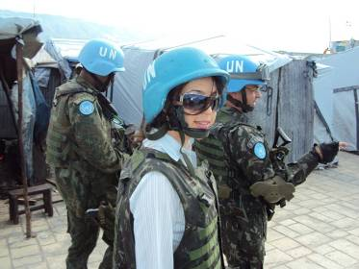
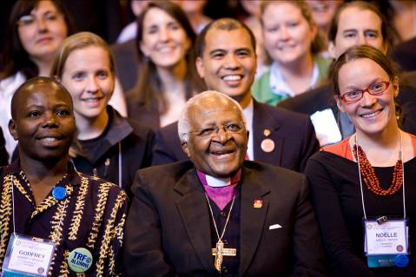
Rotary Peace Fellowships
A Program Overview and Update
Notes:
Suggested audience: Rotary District Conferences, Multidistrict PETS, and Zone Institutes
Presentation provides an overview of the Rotary Centers for International Studies in peace and conflict resolution program

Slide 2
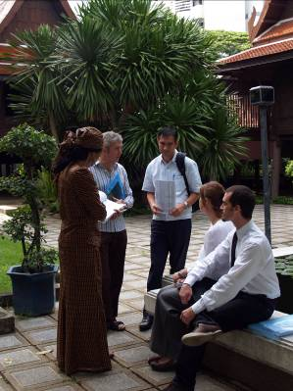
Rotary Peace Centers Program Objectives
Create peace by
1. Advancing research, teaching and study in Peace and Conflict Resolution and related studies
2. Creating and strengthening world peace leaders through advanced education
3. Promoting worldwide tolerance and understanding through Rotarian and Peace Fellow collaboration
A Program of
The Rotary Foundation of Rotary International
Notes:
Statement of Purpose
To honor Paul Harris, the founder of Rotary International, on the 50th anniversary of his death, the Rotary Foundation of Rotary International establishes the Rotary Centers for International Studies for the following purposes:
1. To advance research, teaching, publication and knowledge on issues of peace, goodwill, causes of conflict and world understanding. This scholarship may involve consideration of issues as diverse as population and the environment, technology and science, world politics and economics, religious and cultural traditions, educational opportunities, health, hunger and poverty.
2. To provide advanced educational opportunities for a group of Rotary Scholars, chosen from various countries and different cultures, in order to advance knowledge and world understanding among potential future leaders of government, business, education, media and other professions.
3. To establish a program through which The Rotary Foundation of Rotary International and the member clubs of Rotary International may become increasingly effective in promoting greater tolerance and cooperation among peoples, leading to world peace and understanding.

Slide 3
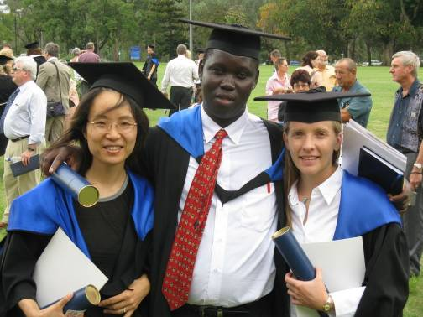
Rotary Peace Center Option 1
Master’s Degree
“Building the leaders of tomorrow”
Five centers, Six universities
15 to 24 month course
10 new fellows at each center each year
Graduates from Rotary Peace Center at the University of Queensland
A Program of
The Rotary Foundation of Rotary International
Notes:
One option is a Master’s Degree program. The Master’s Degree program is building the leaders of tomorrow. There are 5 Rotary Peace Centers at 6 universities around the world hosting this program. The programs range from 15 to 24 months and study timelines differ according to each university’s academic calendar. To apply, a Bachelor degree or its equivalent is required, and eligible candidates must have at least three years of paid or volunteer experience in the field, although six years of work experience in the field is the actual average for the highly competitive Master’s degree program. Each year 10 new fellows are selected for each center. For more information please visit www.rotary.org/rotarycenters.

Slide 4
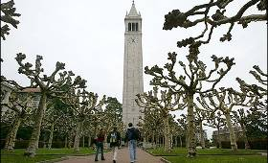
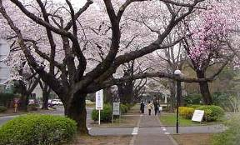
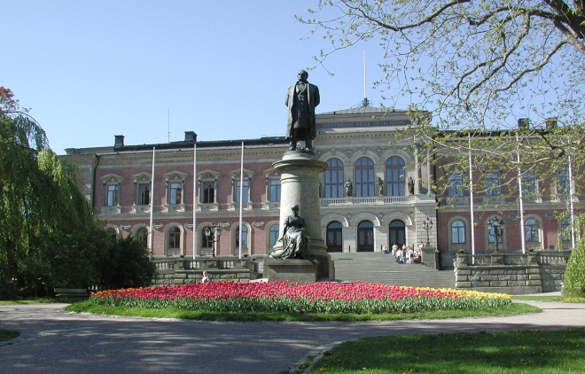
Rotary Peace Centers University Partners for Master’s Program
  5 Rotary Peace Centers at 6 Universities
Duke University and The University of North Carolina at Chapel Hill
International Christian University
The University of Bradford
The University of Queensland
Uppsala University
A Program of
The Rotary Foundation of Rotary International
Notes:
The founders of the Rotary Centers designed the program as a multi-institution partnership between The Rotary Foundation and leading universities around the world. They viewed this partnership as the best approach to achieve the Rotary Peace Centers program objectives. Rotary partners with 6 outstanding Universities at 5 centers offering fellows a Master’s Degree in Peace and Conflict Resolution or a related field (e.g. International Law and Development Policy, Public Health, Urban Planning)

Slide 5
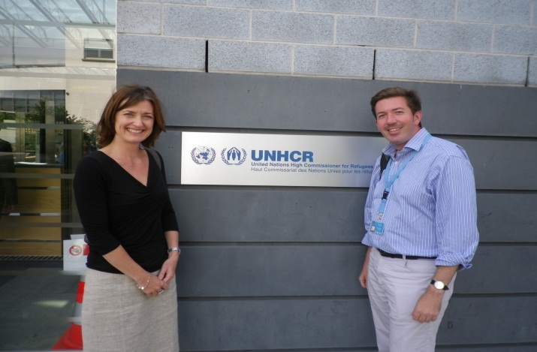
Master’s Program Concept
Structure of Master’s Program
  Core Courses in Peace and Conflict Resolution
  Specialized courses and research to support fellow’s interest
  Applied Field Experience (internship)
  Annual Peace Seminar
Rotary Peace Fellows at United Nations High Commissioner for Refugees (UNHCR) office
A Program of
The Rotary Foundation of Rotary International
Notes:
The Rotary Peace Centers program was created with four primary components in mind at each center:
1. Core courses about Peace and Conflict Resolution
2. Courses and research to support a fellow’s area of interest or specialization
3. Applied Field Experience (Internship). AFEs at UN, Red Cross, Human Rights Watch, The Hague, International Palestinian Youth League, Save the Children
4. Annual Peace Seminar at each university which provides an opportunity for fellows to share research

Slide 6
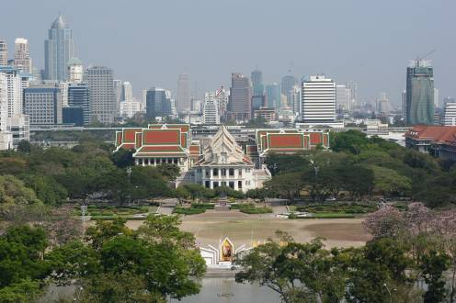
Rotary Peace Center Option 2
Professional Development Certificate
“Strengthening the leaders of today”
One center, one university
Three month course
Up to 25 fellows in each session, up to 50 per year
Chulalongkorn University in
Bangkok, Thailand
A Program of
The Rotary Foundation of Rotary International
Notes:
The second option is a professional development certificate. The certificate program is strengthening the leaders of today. Certificate participants have at least 5 years of experience in the field. The certifcate program is located at the Chulalongkorn University in Bangkok, Thailand. The programs last 3 months and includes up to 3 weeks of field study. There are two sessions per year each which has up to 25 fellows.

Slide 7
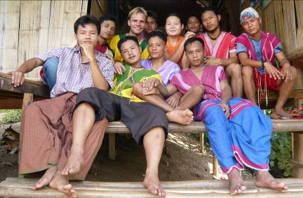
Certificate Program Model
Structure of Certificate Program
Intensive 8 weeks classroom foundational instruction
On-site fieldwork in Thailand and Nepal for 2-3 weeks
Alumni return to their jobs with a professional development certificate in peace and conflict studies
Chula participant Simon Milward
A Program of
The Rotary Foundation of Rotary International
Notes:
Through its unique and diverse interdisciplinary program, the Rotary Peace Center at Chulalongkorn University in Bangkok, Thailand, provides academic and practical training to prepare alumni for leadership roles in solving the many problems that contribute to conflict around the world. In class coursework provides theoretical foundational knowledge. On site fieldwork provides practical experience in applying theoretical knowledge to real-life situations

Slide 8
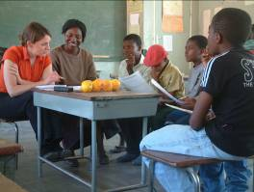
Rotary Peace Centers Updates
New Rotary Peace Center at Uppsala University in Sweden First class underway in September 2012
2015 Rotary World Peace Symposium in Sao Paulo, Brazil
Visioning for Rotary Peace Centers Strategic Plan
Online application being developed to launch 1 July 2013
Targeted marketing/recruitment plan
Rotary Peace Fellows Leadership Retreat, February 2014
An Educational Program of
The Rotary Foundation of Rotary International
Notes:
New Rotary Peace Center at Uppsala University in Sweden. First class to start in Fall 2012:
An exciting development within the last year has been the addition of the newest Rotary Peace Center at Uppsala University in Uppsala Sweden. A top ranking university in peace and conflict studies, the additional of Uppsala provides a strong addition to the academic offerings within the Rotary Peace Center program.
2015 Rotary World Peace Symposium in Sao Paulo, Brazil
Planning will commence this year for the fourth Rotary World Peace Symposium to take place in Bangkok, Thailand. The Rotary World Peace Symposium is a triennial event that provides an opportunity for peace fellows, Rotarians and experts in the field of peace and conflict resolution to come together to discuss the most pressing issues in the field and well as providing a networking opportunity for fellows and Rotarians interested in issues of peace and conflict resolution. Over 600 Rotarians, Peace Fellow alumni and other TRF program alumni attended the 2012 Rotary World Peace Symposium in Bangkok, Thailand, keynoted by 2011 Nobel Peace Prize Laureate Madam Leymah Gbowee.
Visioning for the Rotary Peace Centers program
As 2012 marked the 10th anniversary of the program’s operations, The Rotary Peace Centers Committee conducted a visioning exercise to identify potential areas where the program has opportunity to grow and to improve during its second decade of operation.
Online application for Rotary Peace Fellow candidates – currently being developed in early 2013 for completion and posting no later than 1 July 2013
Targeted marketing/recruitment plan – further research is being conducted to identify Peace and Conflict undergraduate programs and other PCPR programs in targeted geographic areas
Rotary Peace Fellows Leadership Retreat – planning is underway to identify potential sites and approach to agenda development for this issues-focused retreat

Slide 9
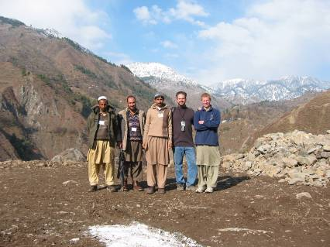
Peace Fellow Alumni
Notes:
The Rotary Peace Centers program has over 700 alumni. 95% of these alumni work in areas related to peace and conflict resolution. The graph shows the percentages of where peace fellows are working. Peace fellows are also scattered across the globe on every continent. 34% are in North America, 22% is Asia, 20% is Europe, 9% is South America, 6% is Africa and 6% is Australia/Oceania. Here are some examples of what peace fellows are doing: World Bank analyst, Media monitoring analyst for NATO, Civil affairs officer with the UN mission in Nepal.

Slide 10
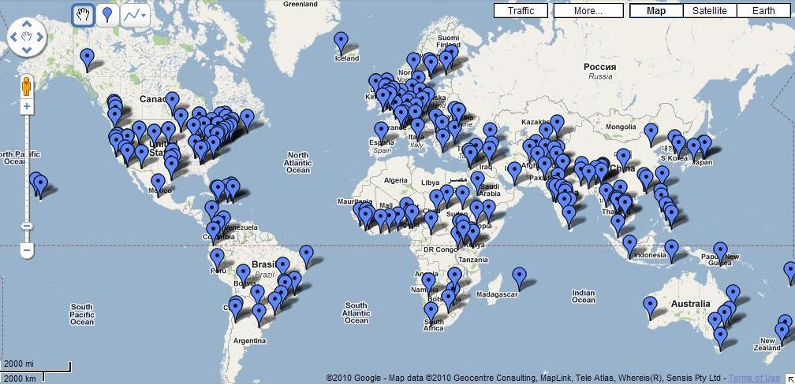
Rotary Peace Fellows – Where they work
Rotary International
Notes:
Approximate distribution location of our 700 Rotary Peace Fellows around the world.

Slide 11
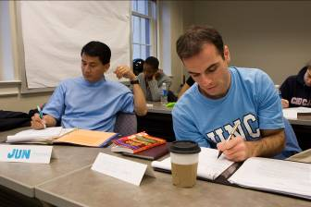
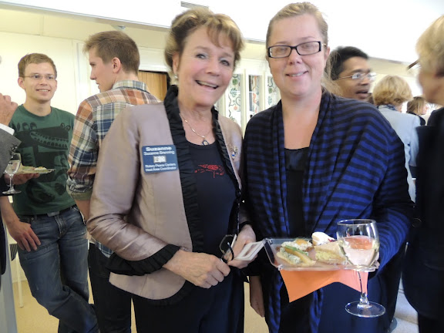
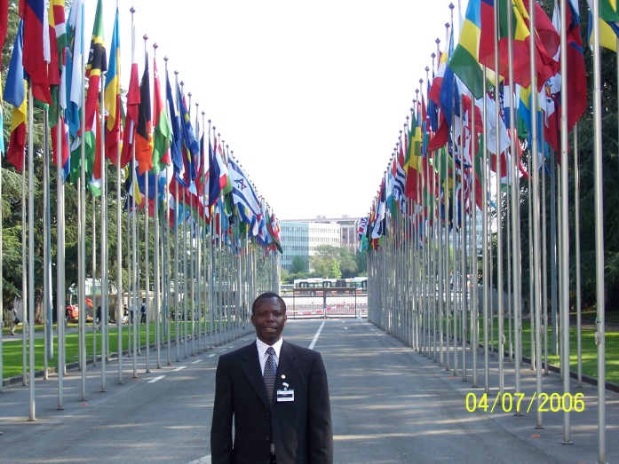
How Can You Help Create Peace?
Recruit Qualified Rotary Peace Fellowship Applicants
Advertise the Rotary Peace Fellowship
Support the program by encouraging your district to become a Peacebuilder District

Slide 12

Successful 2013-2015 candidates
 | All Applicants | Selected Fellows (Masters only) | Selected Fellows (Certificate only)
Gender | 60% Female 40% Male | 58% Female 42% Male | 57% Female 43% Male
Citizenship from Low-Income Country | 58% | 48% | 43%
Average Age | 32 years | 29 years | 39 years
Average # of years of work experience | 7 years | 6 years | 11 years
Previous Work Experience | NGO or MLI: 34% Government: 12% Education: 16% Business/Trade: 8% Peace Building: 6% | NGO or MLI: 47% Government: 12% Education: 6% Peace Building: 6% Law: 6% | NGO or MLI: 38% Education: 21% Government: 16% Peace Building: 7%
Notes:
In addition to the demographic profile shown, successful candidates have a vested interest in returning to the field after their fellowships are concluded. They also have a record of academic success and the strong support of local Rotarians and recommendations.

Slide 13
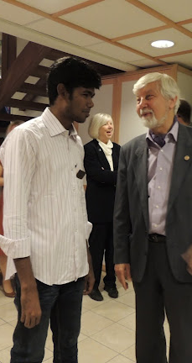
Recruit: Where to find applicants?
Partner with Community Organizations
University alumni associations and career offices
Returned Peace Corps volunteers
Former Ambassadorial Scholars
Department of international studies, political sciences or peace studies at your local universities or colleges
Non-governmental organizations involved in peace and conflict resolution
International organizations and corporations in
your community
Governmental agencies, diplomatic corps,
local police and military offices

Slide 14
Applying: A Three Tiered Process
Rotary Club
Club locator: www.rotary.org/clublocator
Rotary District
The Rotary Foundation
*World Competitive Selection

Slide 15
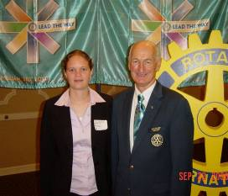
The Application Timeline
Jan-May
Clubs interview, select and endorse applicants and send to districts
Jan- June
Districts interview, select and endorse applicants and send to The Rotary Foundation for processing
January- April
Clubs and Districts recruit applicants
All Applications Due by 1 July!
October
Fellows selected in a world-competitive selection process by the selection committee
June- September
TRF processes applications. Districts will receive confirmation email when completed application is received
Notes:
In the beginning of the year, clubs and districts recruit potential applicants. A guide for Rotarians is available on the Rotary Peace Centers web page. Through May clubs will interview, select and endorse applicants. Club Presidents and a sponsor counselor will sign the application and then send the application to the district-level. Districts will then interview, select and endorse candidates. DGs and DRFCs must endorse the application and send completed application to The Rotary Foundation preferably via email. All applications are due by 1 July. District DG, DRFC and club presidents will receive a confirmation when a completed application is received. Please note that incomplete applications will not be processed until all material is received. Complete applications are processed through 15 September. Districts may submit any number of qualified, endorsed applicants. The Rotary Peace Centers Committee selects up to 60 Master’s Fellows and up to 50 certificate Fellows in October. All applicants and their supporting Rotarians will be notified of applicant’s status by early November.
Note: Applications submitted each 1 July are for the upcoming year master’s degree fellowships and upcoming January and June professional development certificate fellowships. Example: Applications due 1 July 2013 are for Master’s degree fellowships starting in 2014-15 and certificate programs in 2014.

Slide 16
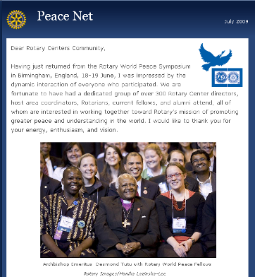
Advertise: Publicity and Publications
Subscribe to the Peace Net Newsletter by sending an email to rotarypeacecenters@rotary.org
Recruit Fellows with the help of the Program Guide for Rotarians available at www.rotary.org
Spread the word on your listservs and refer them to Rotary Peace Centers videos on Vimeo, YouTube and the Rotary web site.

Slide 17
Rotary Peace Centers
Major Gifts Initiative
US $80 million raised toward the goal of US $95 million by 30 June 2015 to support the program. The Major Gifts Initiative goal includes:
Endowed Gifts goal of US $90 million
Term Gifts goal of US $5 million (emphasizing gifts of US$50,000 or more)
Districts worldwide contribute DDF as well to a pool of funds supporting the fellowships
Notes:
The Rotary Peace Centers Major Gift Initiative shares the stage with PolioPlus as one of TRF’s highest priorities. Unlike PolioPlus, which is a broad-based initiative, the Rotary Peace Centers Initiative emphasizes gifts of $50,000 or more.
The focus of this Major Gifts Initiative is endowed gifts. In addition to the $90 million endowment goal, an additional $5 million in term (fully expended) gifts has been included as a goal to help with the immediate expenses of running the program.
Approximately 2,600 individuals from throughout the world have contributed gifts and commitments to The Rotary Peace Centers. DDF transfers to the endowment also support the initiative.

Slide 18
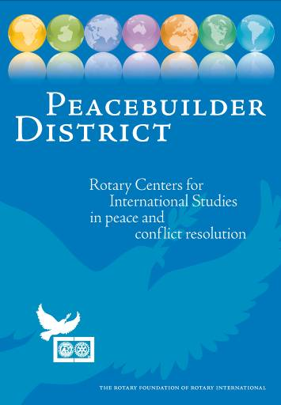
Donate: Peacebuilder Districts
Allocate a minimum of US$50,000 over two years from their District Designated Funds
Continue to donate US$25,000 a year in DDF to maintain Peacebuilder Status
Receive specialized Peacebuilder District banner, peace pins and certificate as well as the opportunity to “adopt” a peace fellow
To become a Peacebuilder District contact the Rotary Peace Center Program Coordinator at Niki.Fritz@rotary.org.
Notes:
Peacebuilder Districts allocate a minimum of US$50,000 over two years from their District Designated Funds to support Rotary Peace Fellows. Districts committed to building peace continue to donate US$25,000 a year in DDF to maintain their Peacebuilder Status. For their generous commitment, Peacebuilder districts are recognized by The Rotary Foundation with a specialized Peacebuilder District banner, peace pins and certificate. Peacebuilder District Banner shown above
Peacebuilder Districts also have the opportunity to “adopt” a peace fellow and follow the experience of being a Rotary Peace Fellow. From annual reports to summaries of fellows’ Applied Field Experiences around the world to career and project updates, your district will hear how peace is being created in the world. Reading and listening to fellows’ stories will illuminate what Rotary is doing in practical ways to make this a more peaceful world.
Take the Next Step to Create Peace
To become a Peacebuilder District or learn more about donating DDF to the Rotary Peace Centers Program, please contact Niki Fritz, Program Assistant, Rotary Peace Centers Department, The Rotary Foundation, 1560 Sherman Ave, Evanston, IL 60201; fax: +847 556 2141; e-mail: Niki.Fritz@rotary.org.

Slide 19
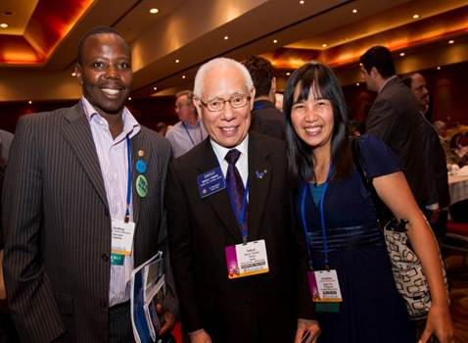
Further Information
Contact Information
For application processing, recruitment or promotional questions contact:
Niki Fritz
niki.fritz@rotary.org
For general information contact:
rotarypeacecenters@rotary.org

